Slide 1
Single-trial detection of EEG/ERP brain responses
Basics on EEG and ERPs
Rationale for estimating brain responses trial-by-trial
Approaches for single-trial estimation
Possible applications

Slide 2
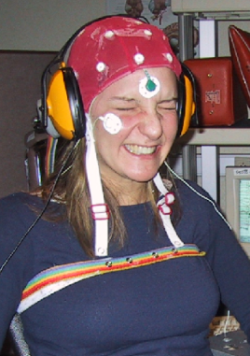
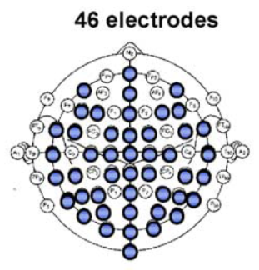
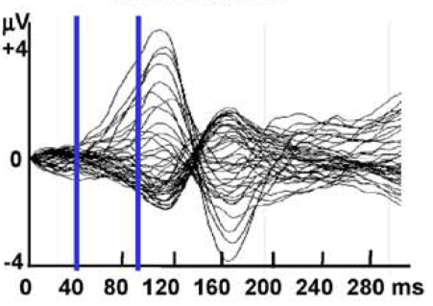
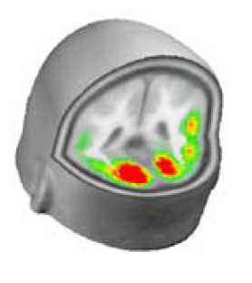
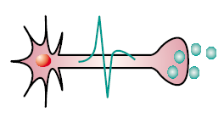
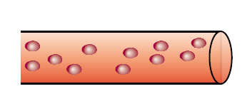
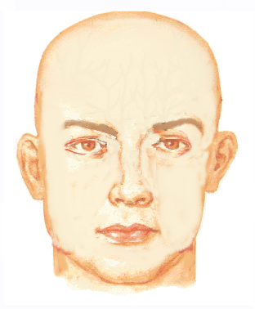
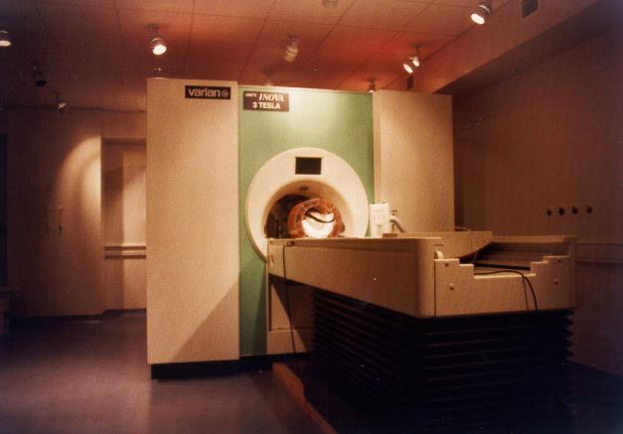
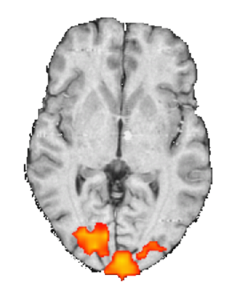
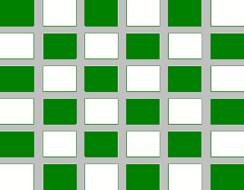
Basics concepts of functional neuroimaging: EEG vs BOLD-fMRI
Scalp EEG
sensory
stimulus
neurovascular
coupling
BOLD
fMRI
neural activity
haemodynamic response

Slide 3
EEG vs BOLD-fMRI: things to remember
Scalp EEG
Samples neural activity directly
Excellent temporal resolution (order of ms)
Reasonable spatial resolution (~5 mm: but depending on several factors)
Need of a priori-hypotheses (source numbers and locations)
Some experimental constraints (e.g. stimulus features)
BOLD fMRI
Samples consequences of neural activity (or other phenomena with PET)
Extremely low temporal resolution (hundreds of ms to several seconds)
Good spatial resolution (2-10 mm; but limitations due to signal nature)
No need of a priori-hypotheses (source numbers and locations)
More flexible stimulation paradigms
Some experimental constraints due to the scanner environment
Notes:
Concepts of spatial and temporal resolution

Slide 4
Basics concepts of functional neuroimaging: EEG vs BOLD-fMRI
Scalp EEG
sensory
stimulus
neurovascular
coupling
BOLD
fMRI
neural activity
haemodynamic response
Notes:
That we have already seen, showing EEG and fMRI, two of the most widely used techniques to sample brain activity. While EEG has an excellent ability to resolve two neural events in time, its ability to resolve neural events in space is quite poor, and exactly the opposite happens for fMRI – this because the different nature of the physiological processes sampled. For this reason it is highly desirable to combine them, and how to do this in a proper way is one of the hot topic of modern system neuroscience, because it could potentially provide maps of brain activity with very high spatial and temporal resolution.

Slide 5
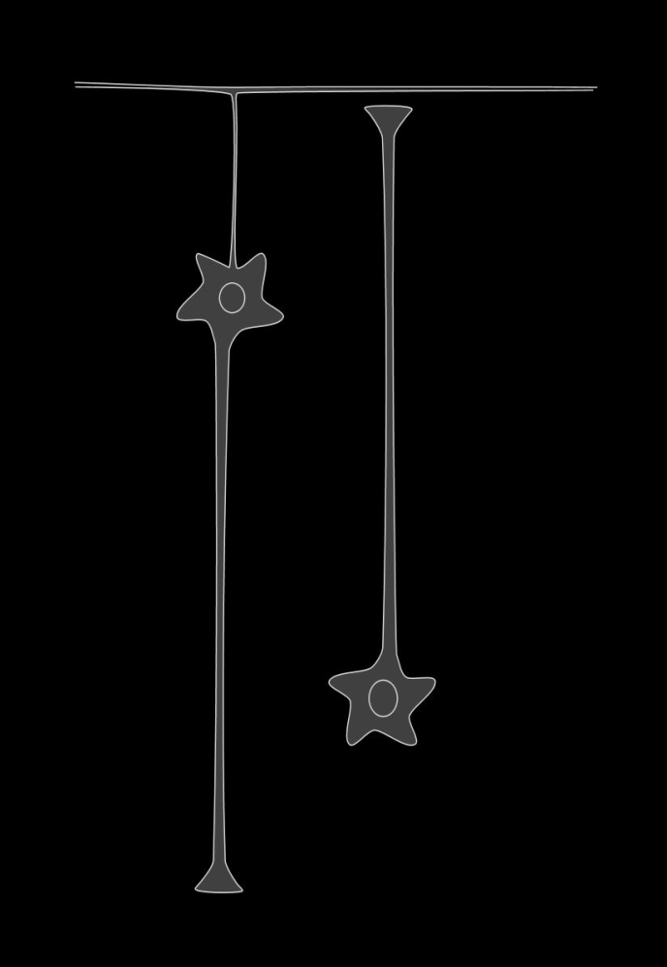
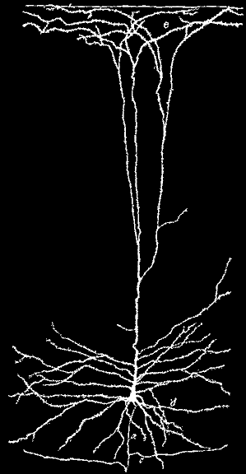
the neocortical pyramidal neuron
(www.krasnow.gmu.edu/alexei/cinema/virt3/intro.html
(adapted from Ramon Y Cajal, 1905)

Slide 6
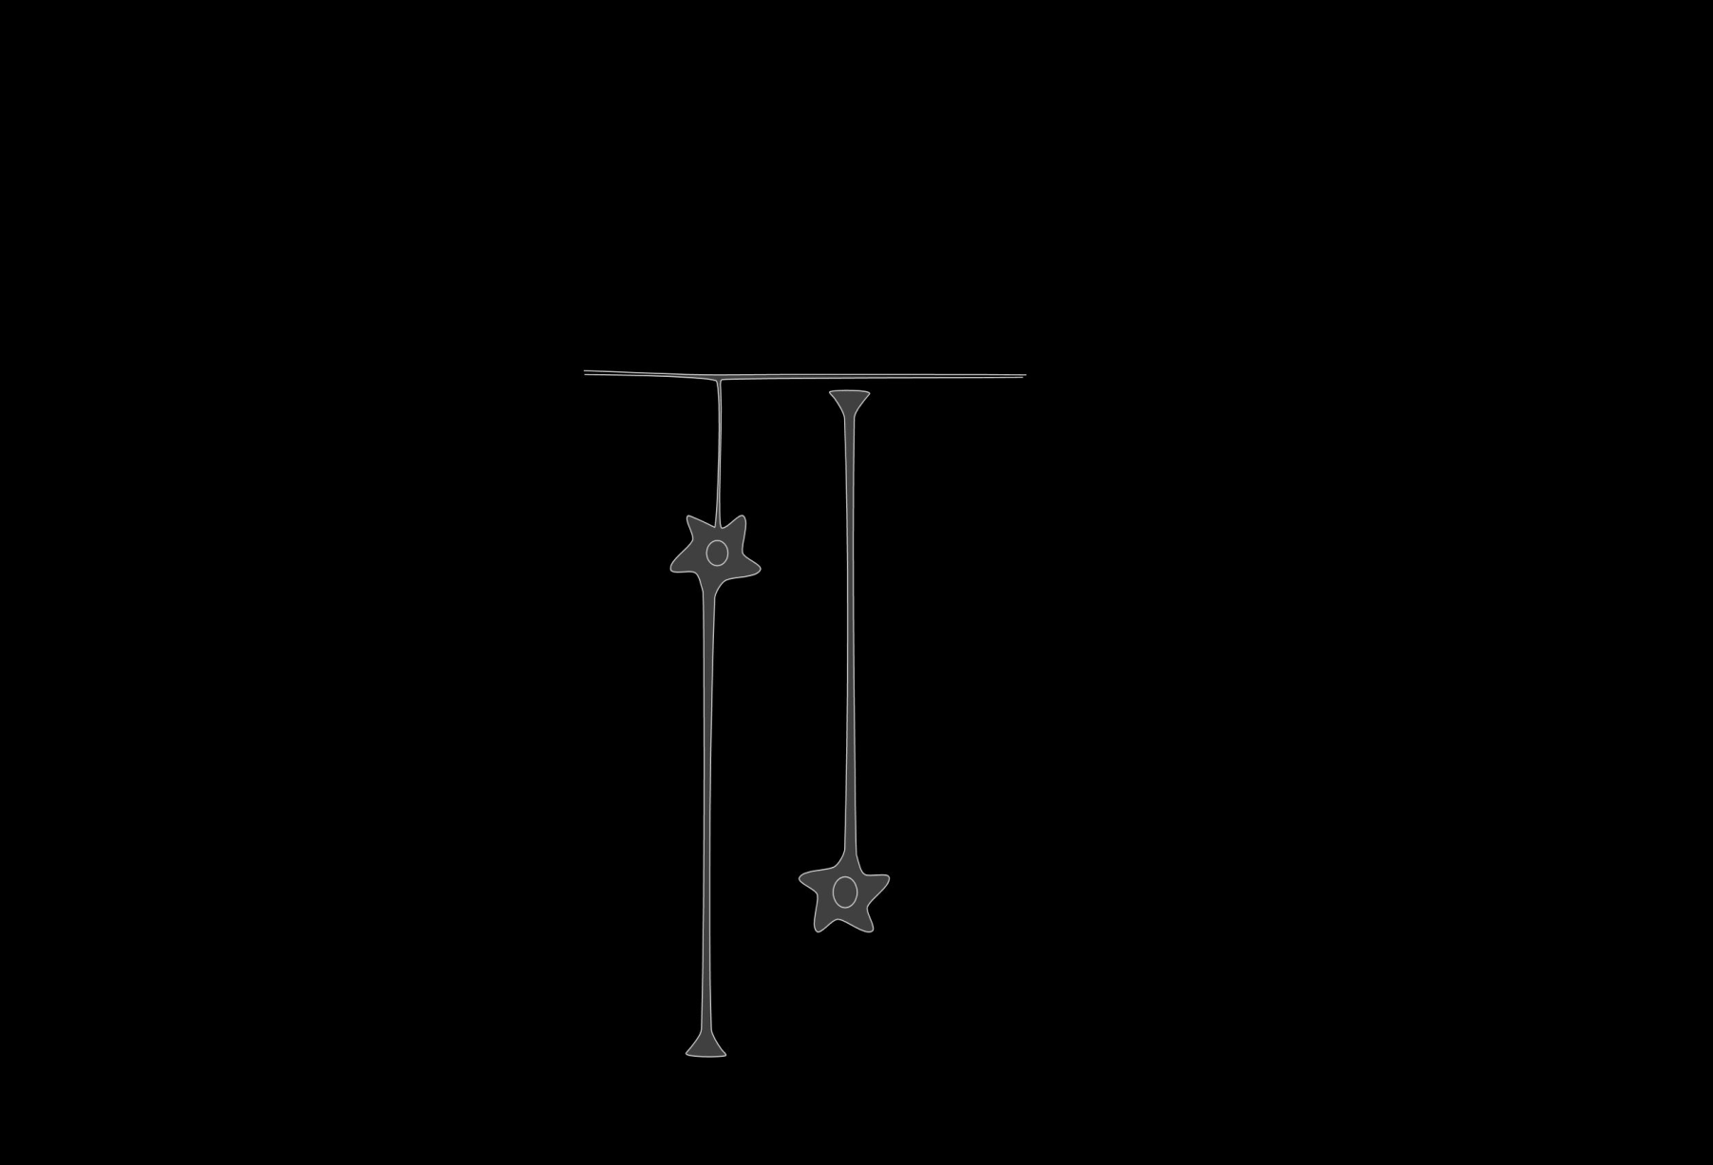
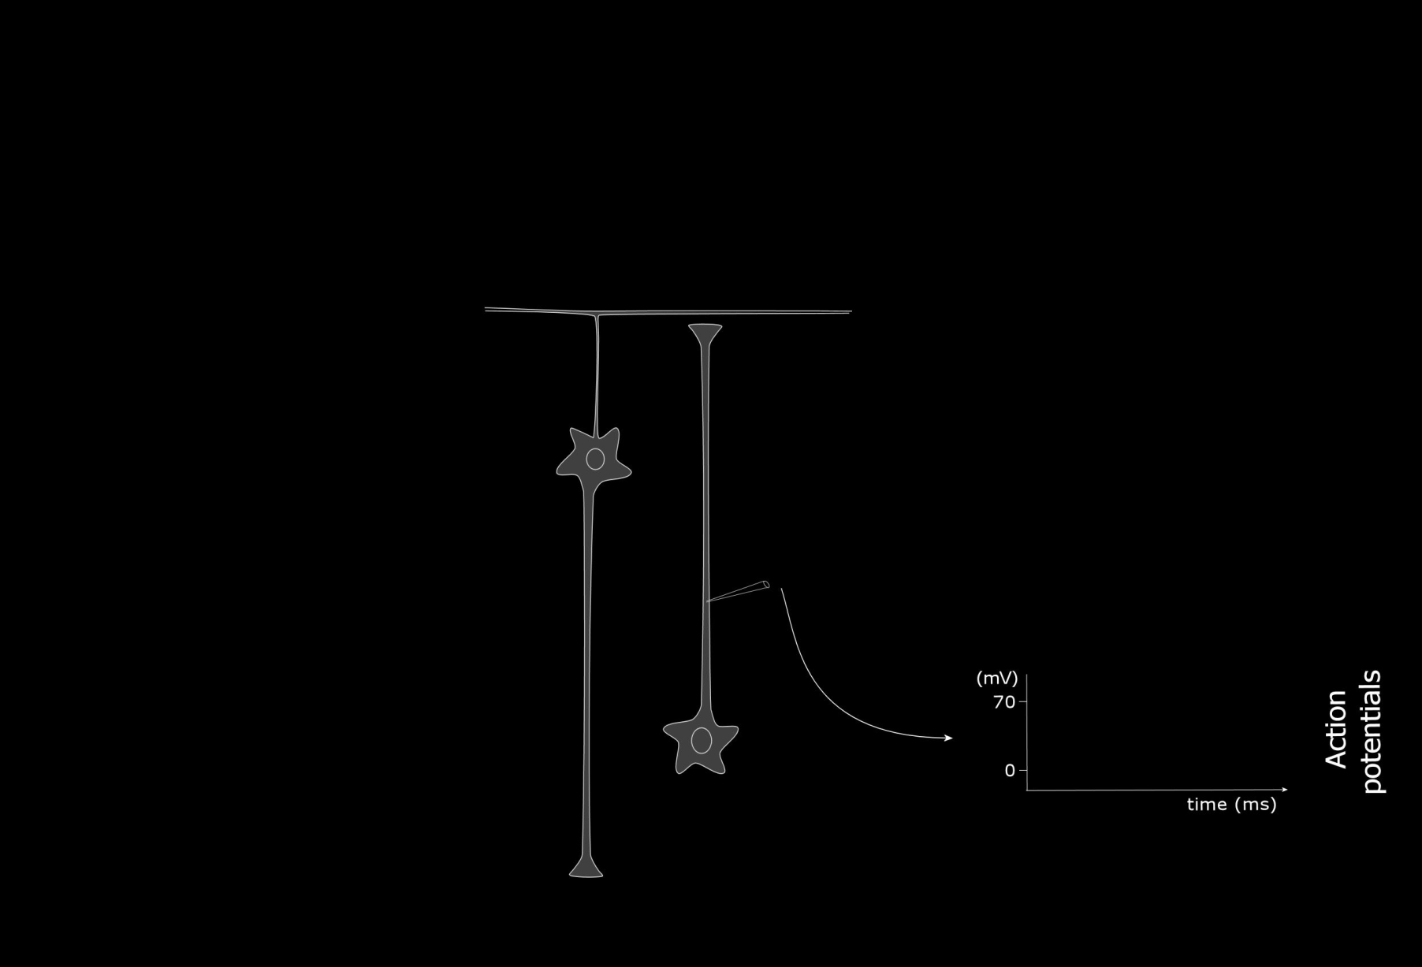
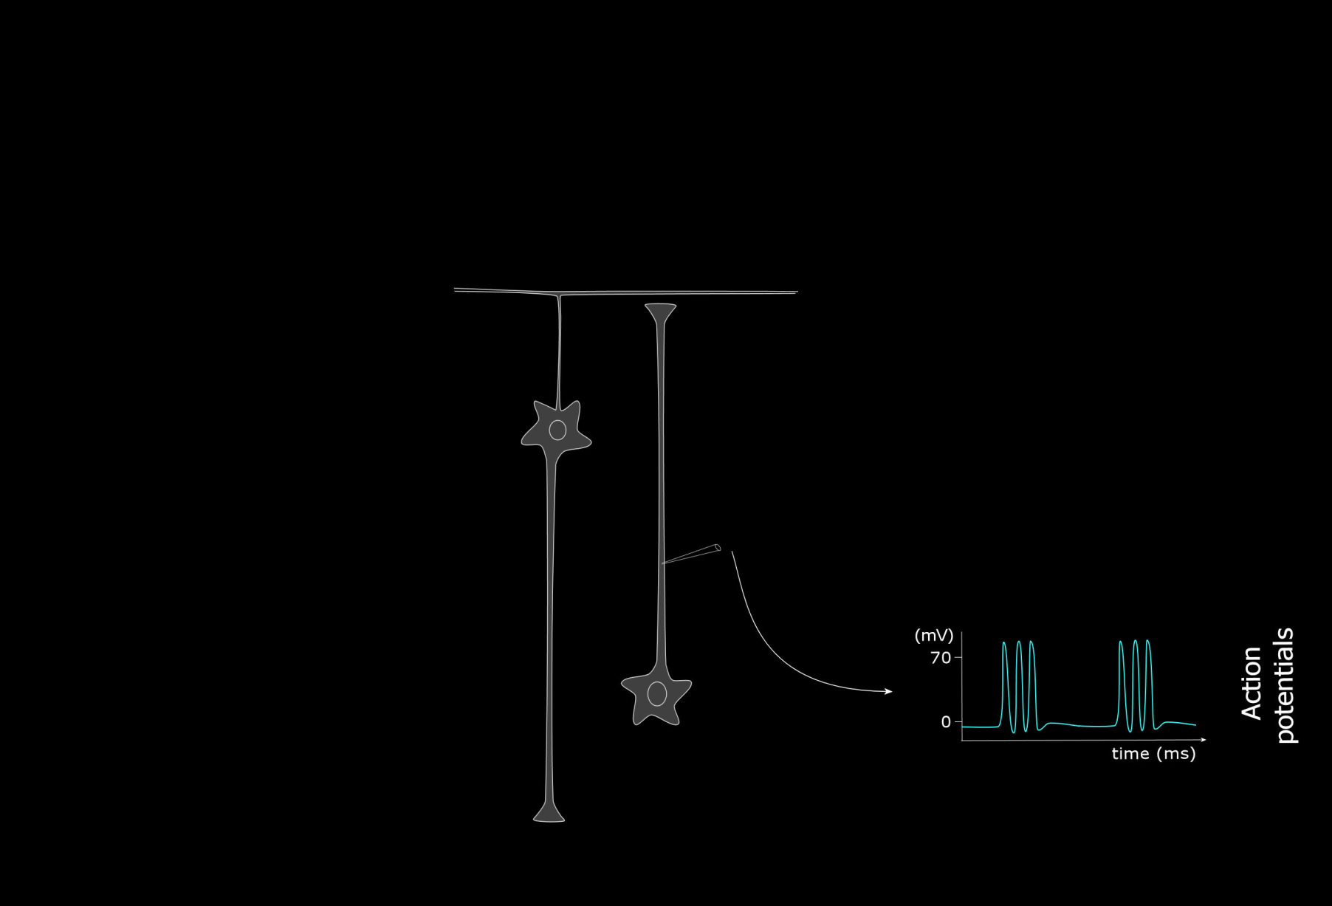
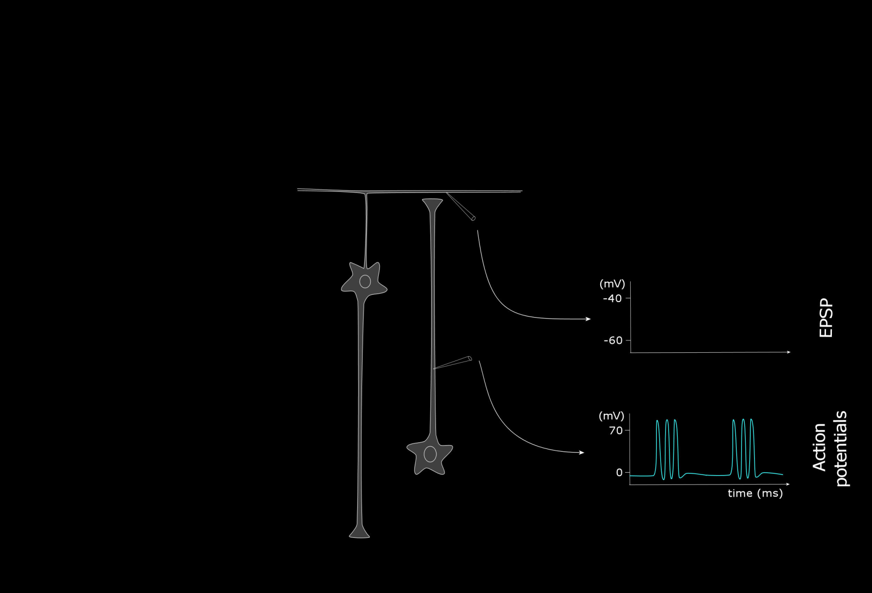
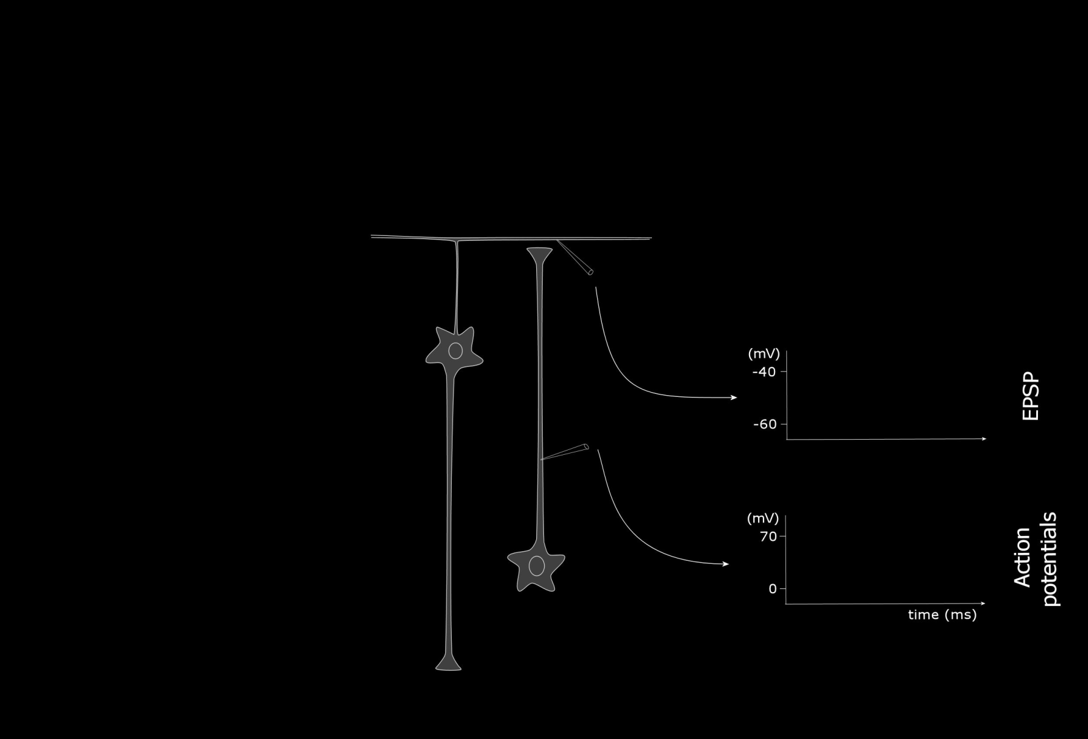
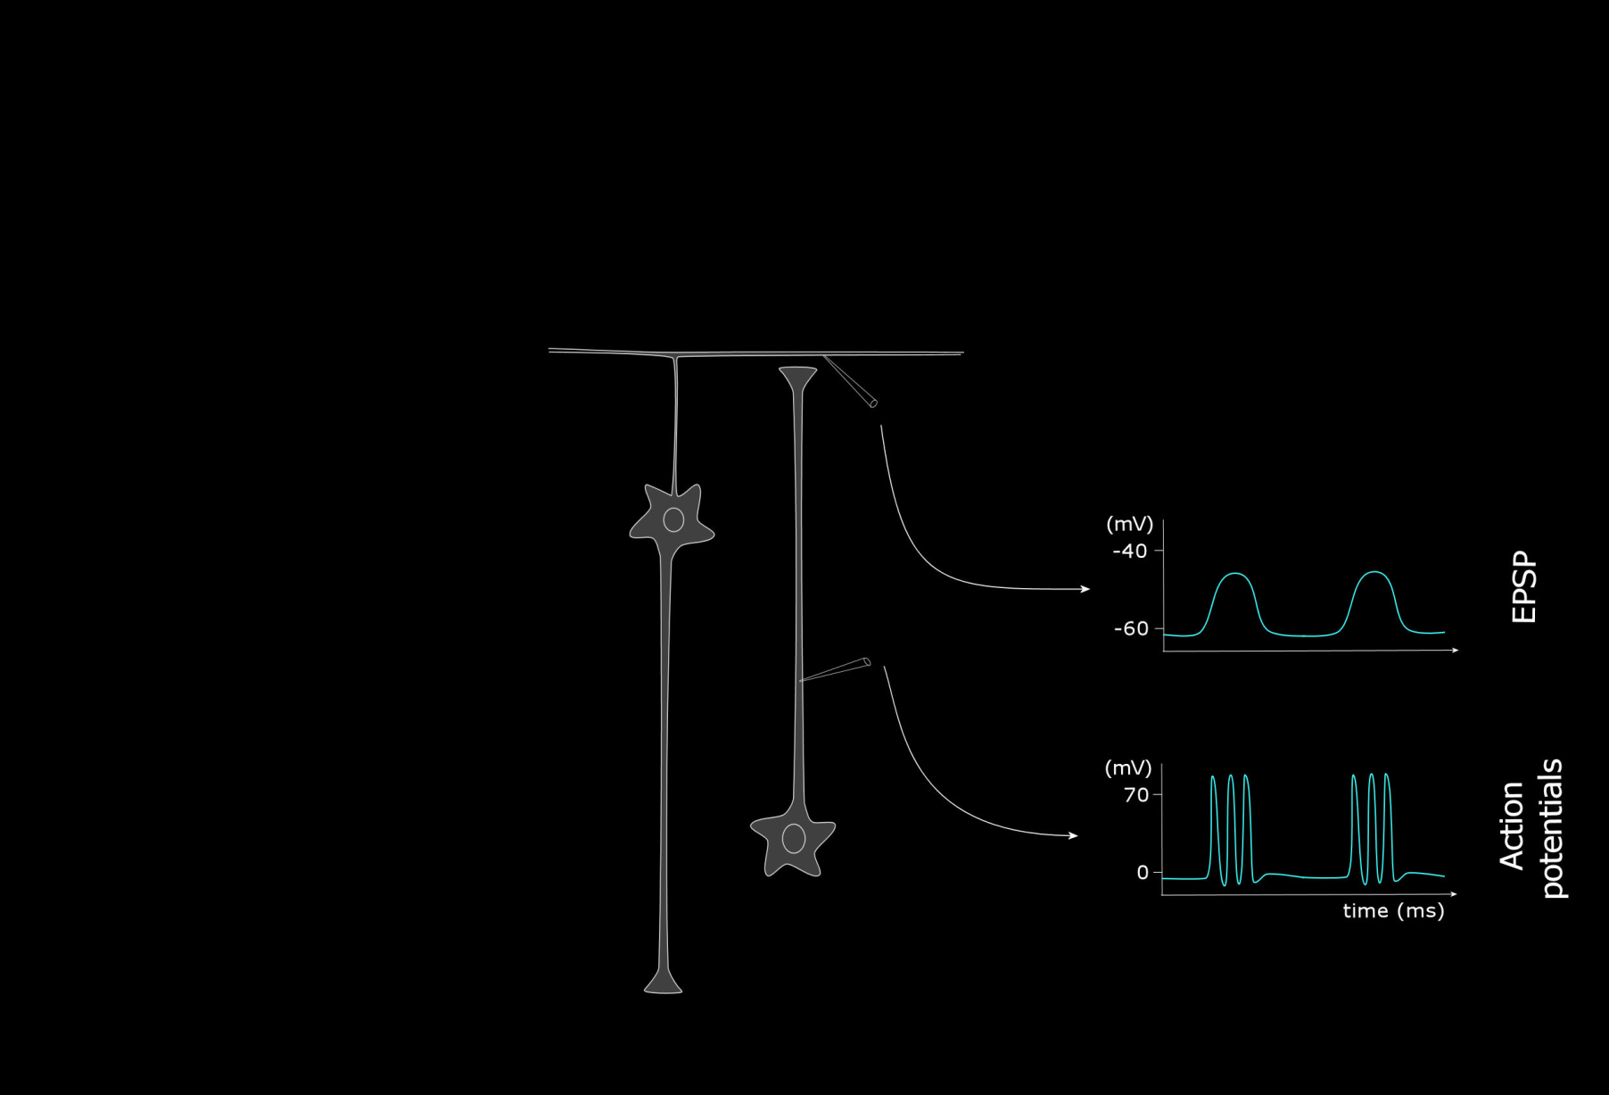
basics of cortical electrophysiology

Slide 7
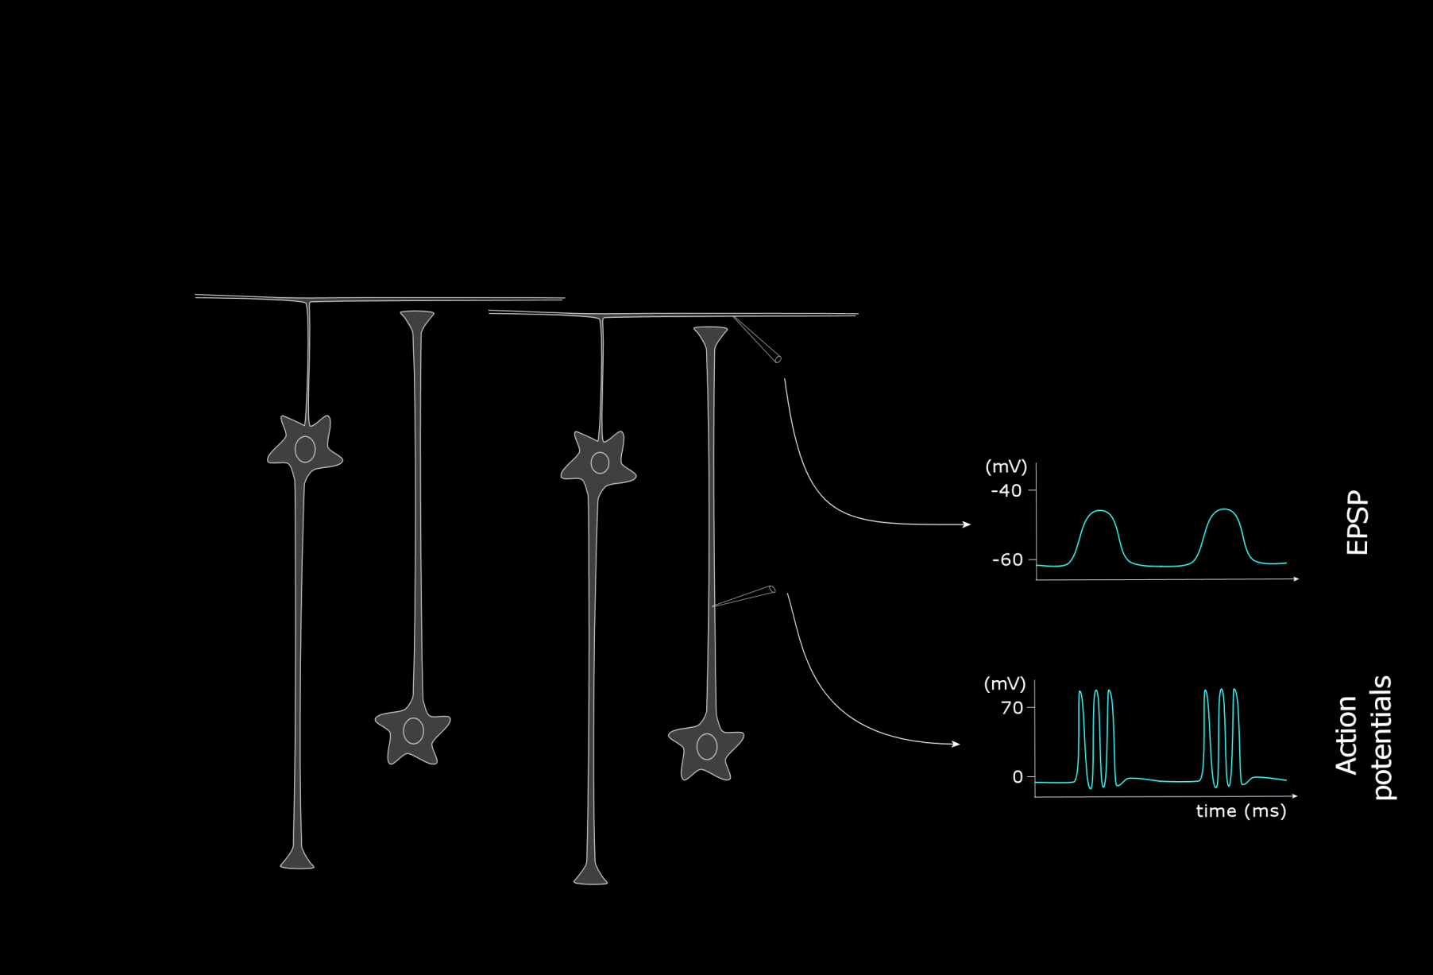
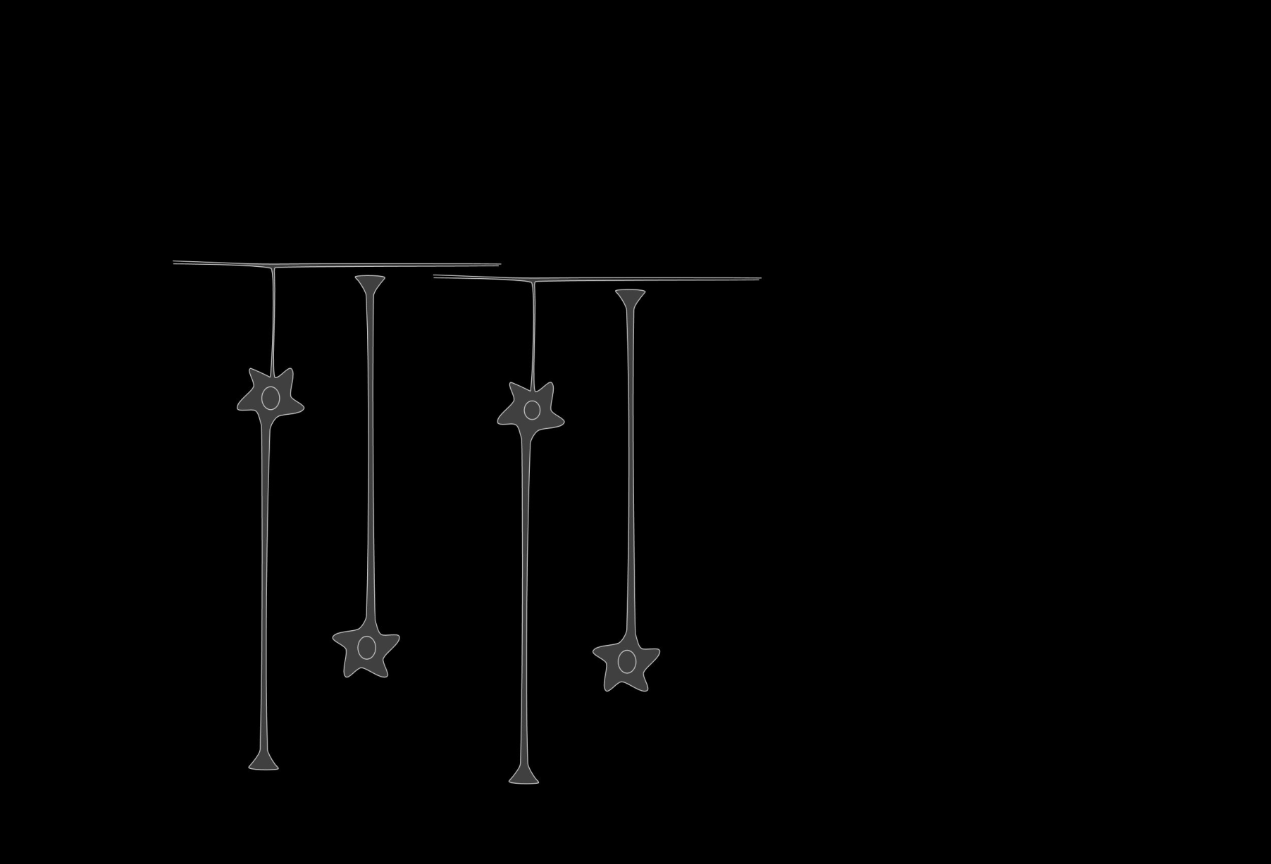
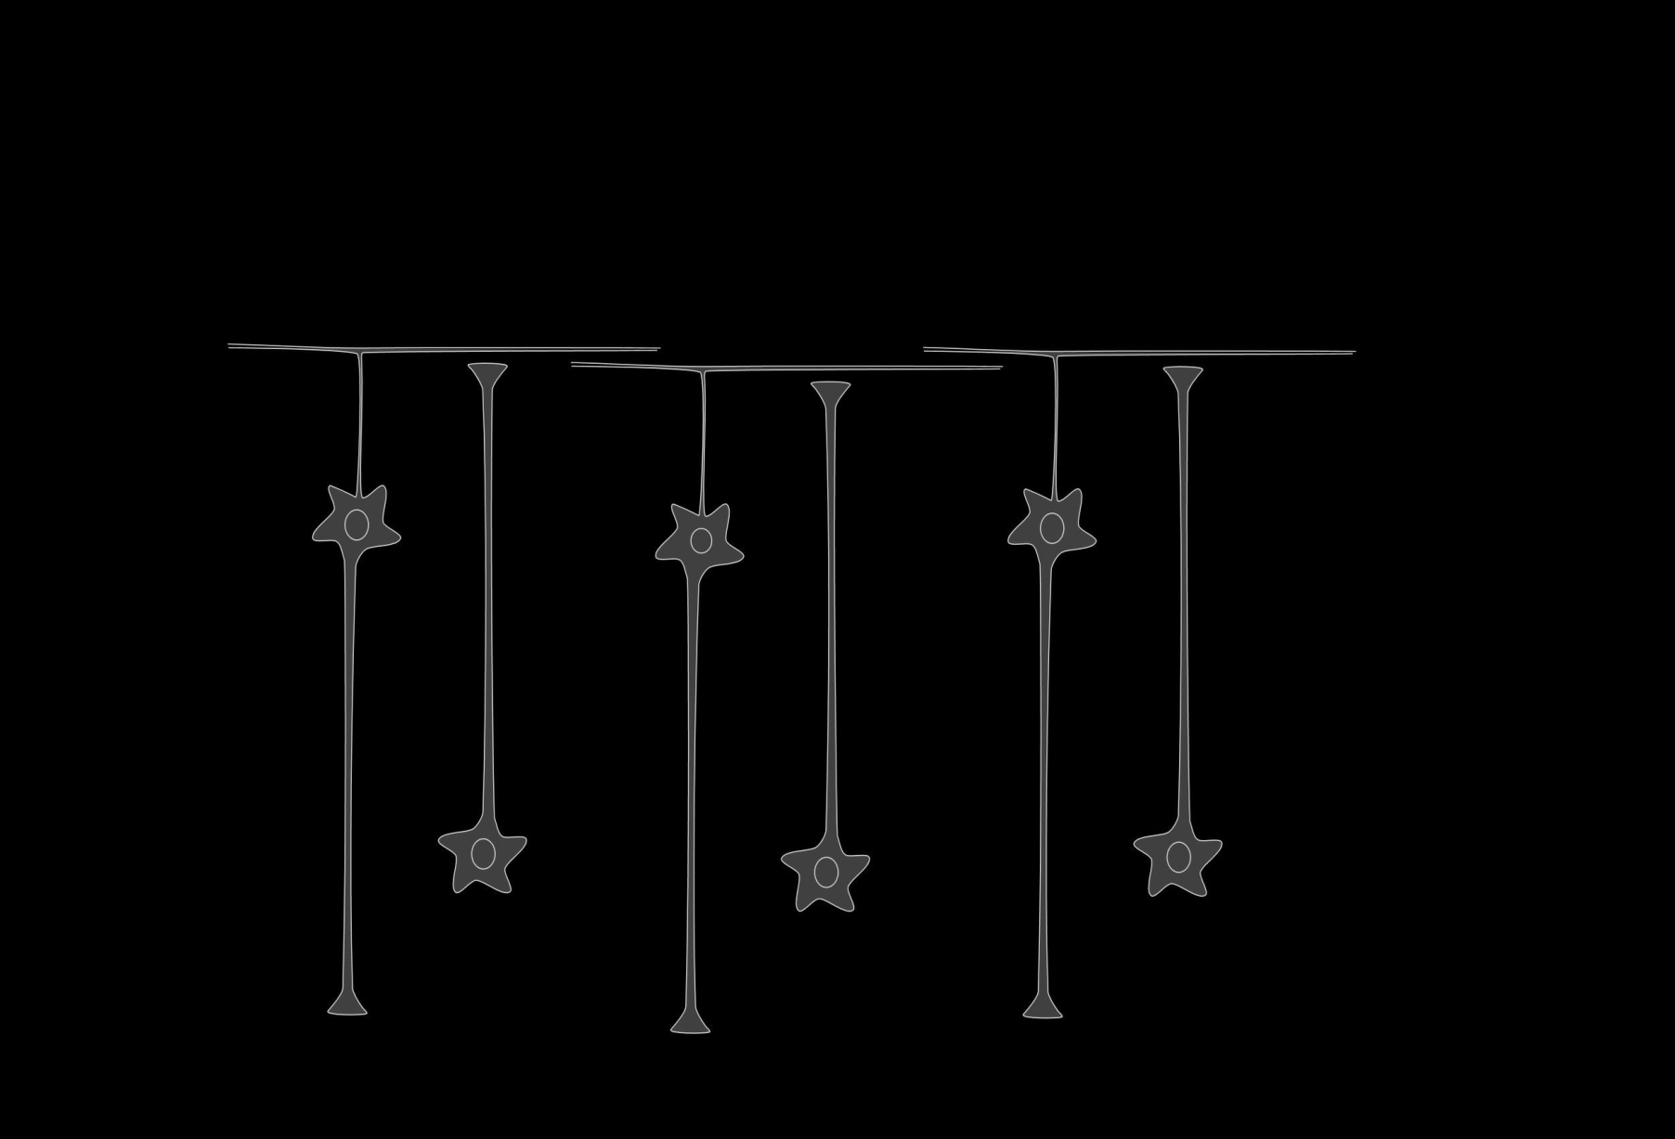
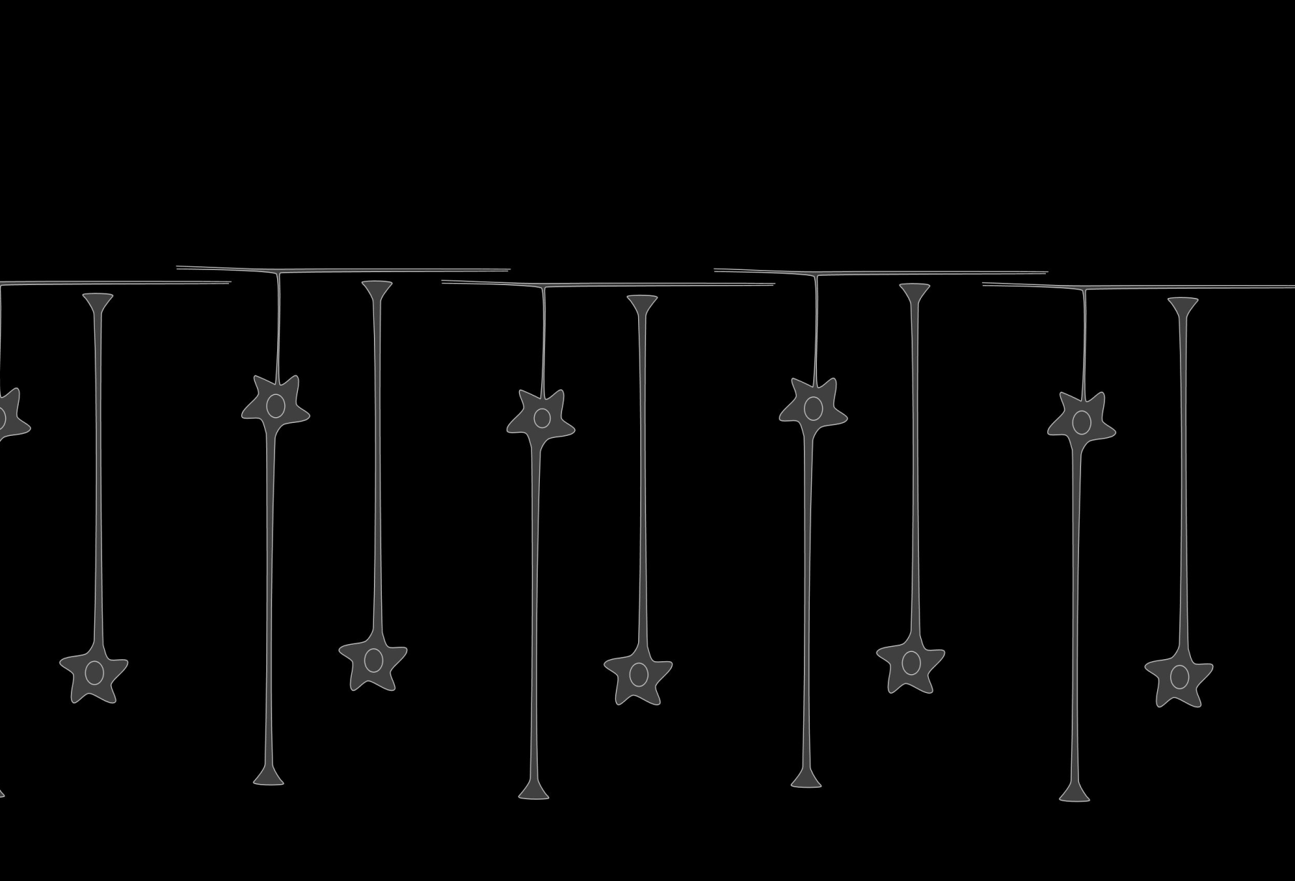
cortical architecture

Slide 8
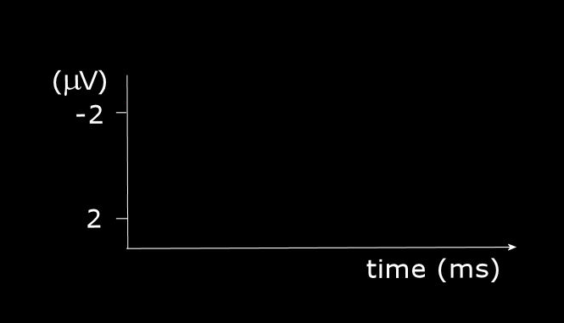
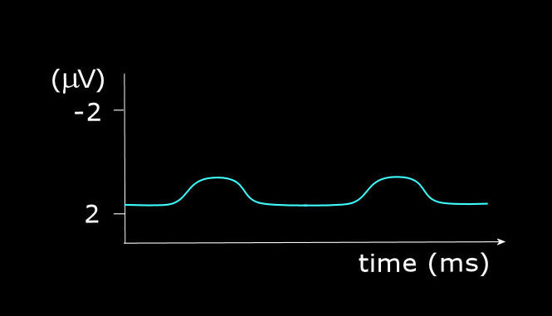
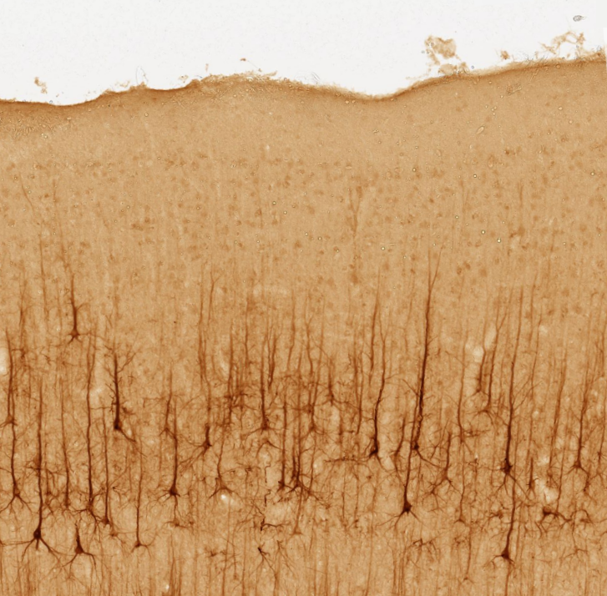
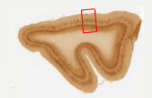
scalp EEG
SCALP
ELECTRODE
SKULL
(adapted from brainmaps.org)

Slide 9
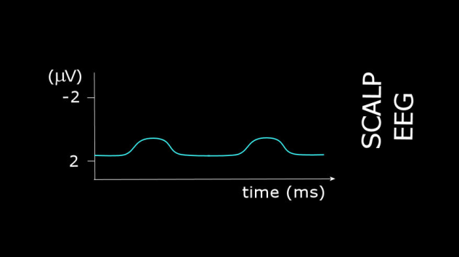
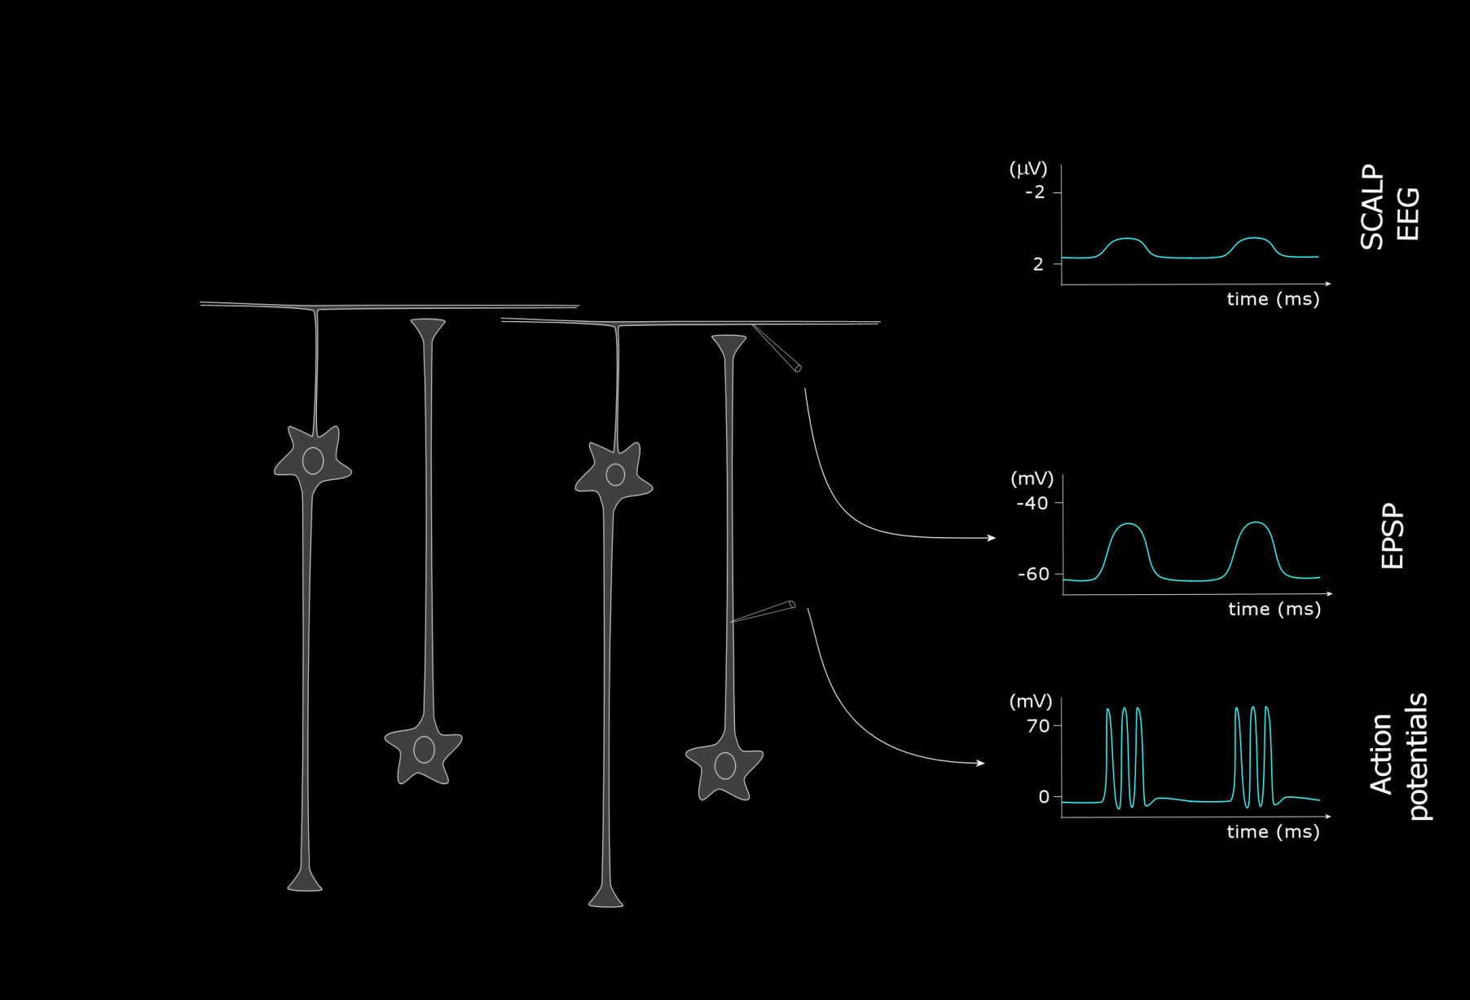
scalp EEG vs direct cortical recording: magnitude differences
SCALP
ELECTRODE
SCALP
ELECTRODE
SKULL
SKULL

Slide 10
Event-related EEG potentials (EPs) – Basics of filtering

Slide 11
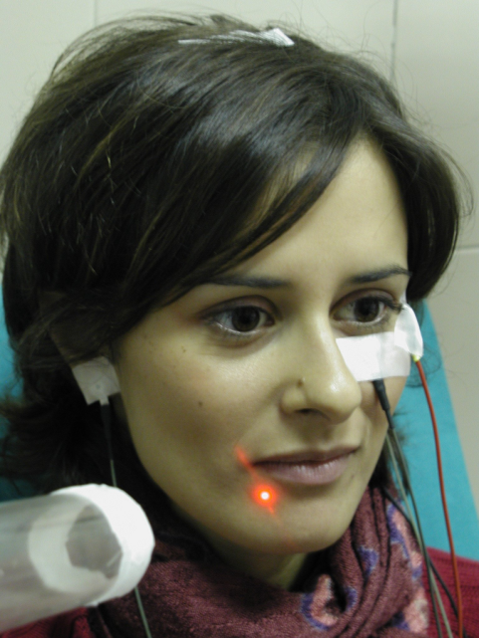
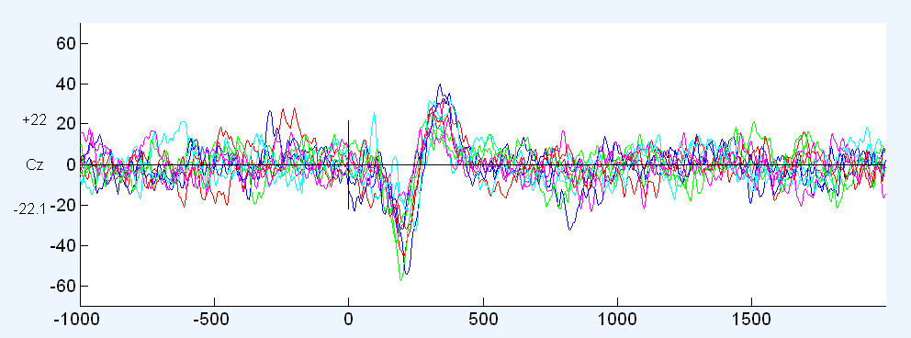
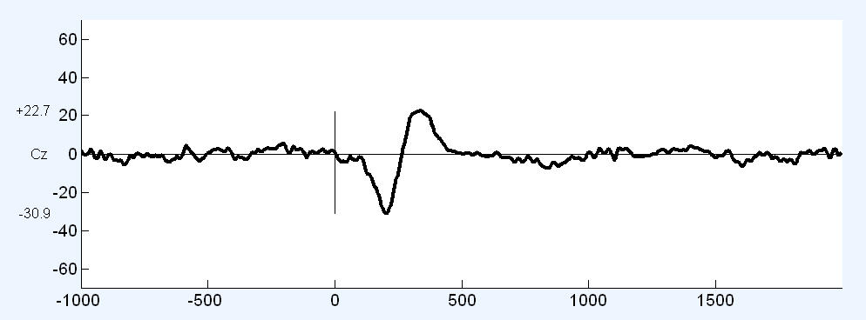
Event-related EEG potentials (EPs) – Basics of averaging
phasic sensory stimulation evokes EEG potentials (EPs)
[averaging across-trials]

Slide 12
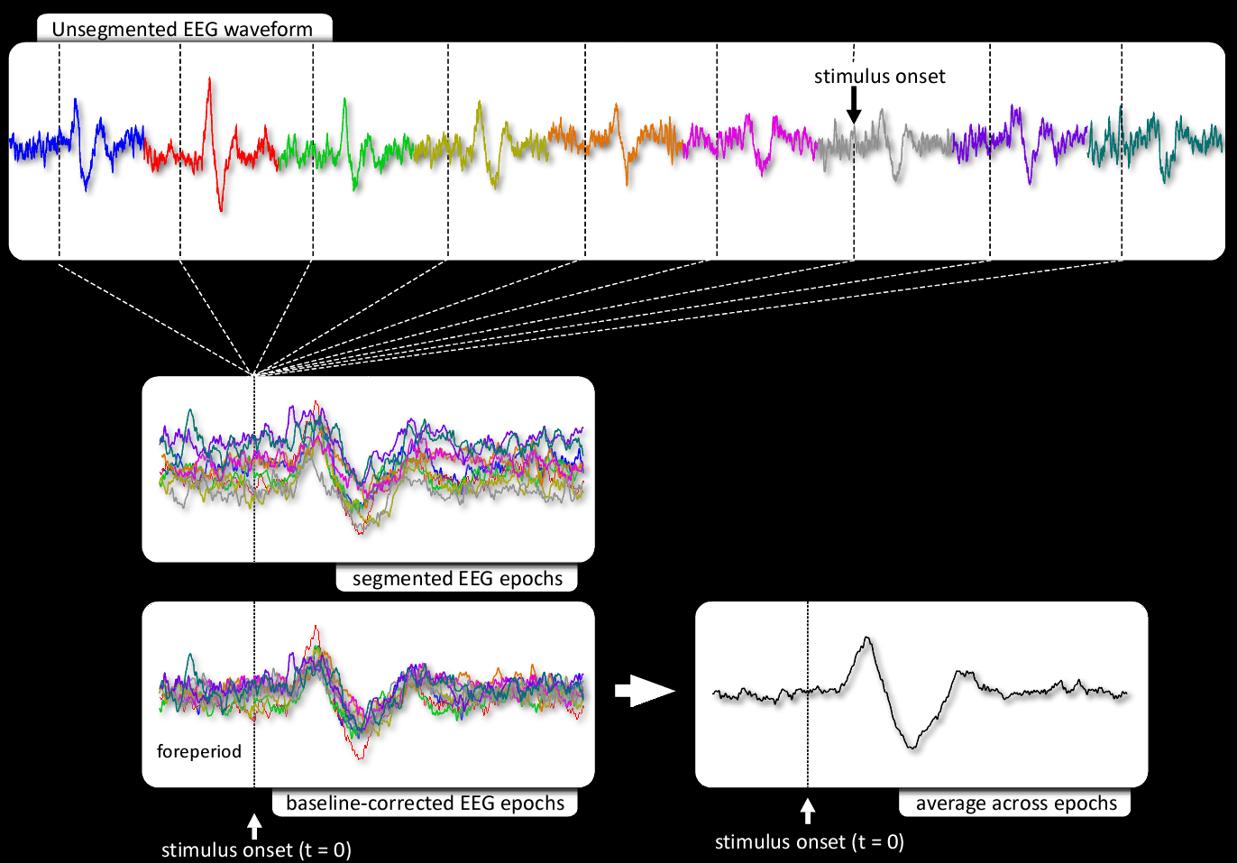
Event-related EEG potentials (EPs) – Basics of averaging

Slide 13
Take home messages – across-trial averging
The magnitude of ERPs is often several factors smaller than the magnitude of the background electroencephalogram.
Across-trial averaging is a widely-used approach to enhance the signal-to-noise ratio (SNR) of both evoked induced EEG responses.
The phase of ongoing EEG oscillations is not stationary across trials. Therefore, as these ‘non-phase-locked’ oscillations behave like uncorrelated noise, they are largely cancelled out by time-domain averaging.
Across-trial variability of response latency and amplitude contains physiologically-relevant information (fluctuations of peripheral input, vigilance, attentional focus and task strategy). This is lost when across-trial averaging is performed.
The availability of such information would allow a direct exploration of the dynamics between different features of ERPs, behavioural variables and measures of brain activity sampled using different neuroimaging techniques.

Slide 14
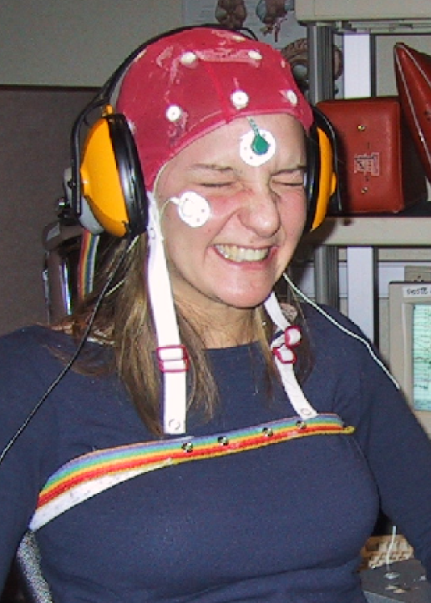
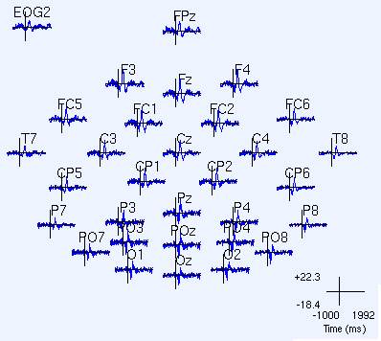
Event-related EEG potentials (EPs) – Multichannel recording
When more than one electrode is used, the average EPs can be plotted according to the relative position of each electrode on the head, thus providing some spatial information on potential distribution.

Slide 15
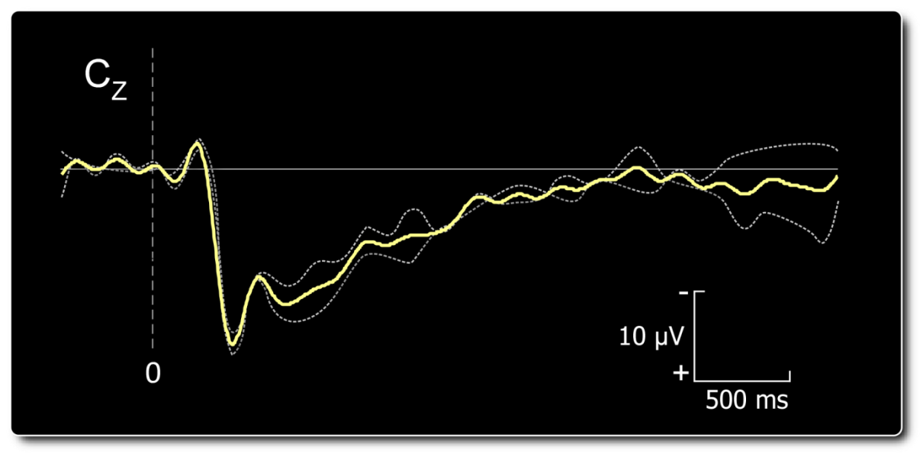
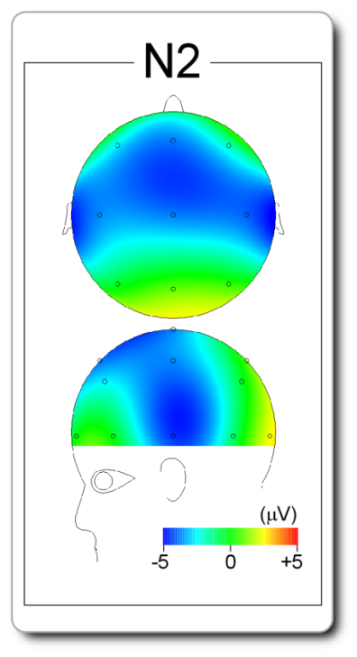
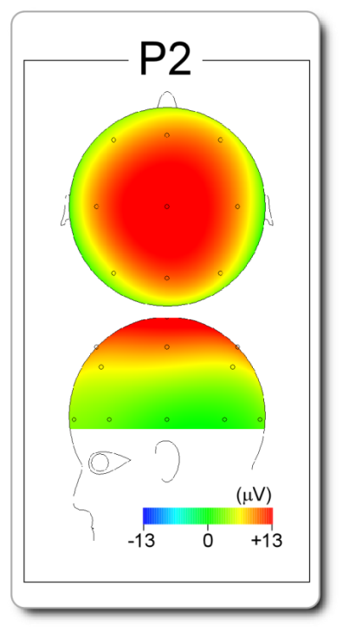
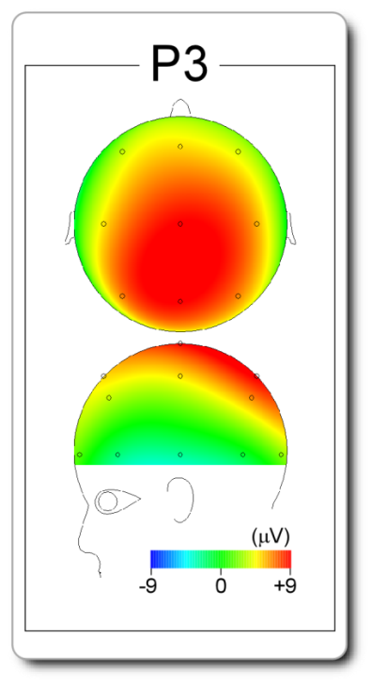
Event-related EEG potentials (EPs) – Overview
200-250 ms
350-400 ms
500-600 ms
Peaks are characterised by their latency, polarity, amplitude and scalp topography

Slide 16
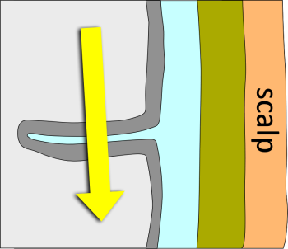
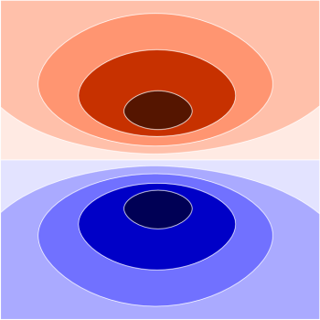
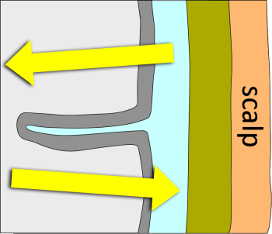
source analysis of event-related EEG potentials (EPs)
The “forward problem”
The “forward problem” is well defined and has a unique solution.
For a given brain electric source distribution and a given head volume conductor, the “forward problem” determines the source-generated electric field.
The “inverse problem”
The “inverse problem” is ill defined and has an infinite number of solutions.
For a given electric field, and a given head volume conductor, the “inverse problem” estimates the location and extent of the brain electric sources.

Slide 17
Event-related EEG potentials (EPs) – Basics of averaging

Slide 18
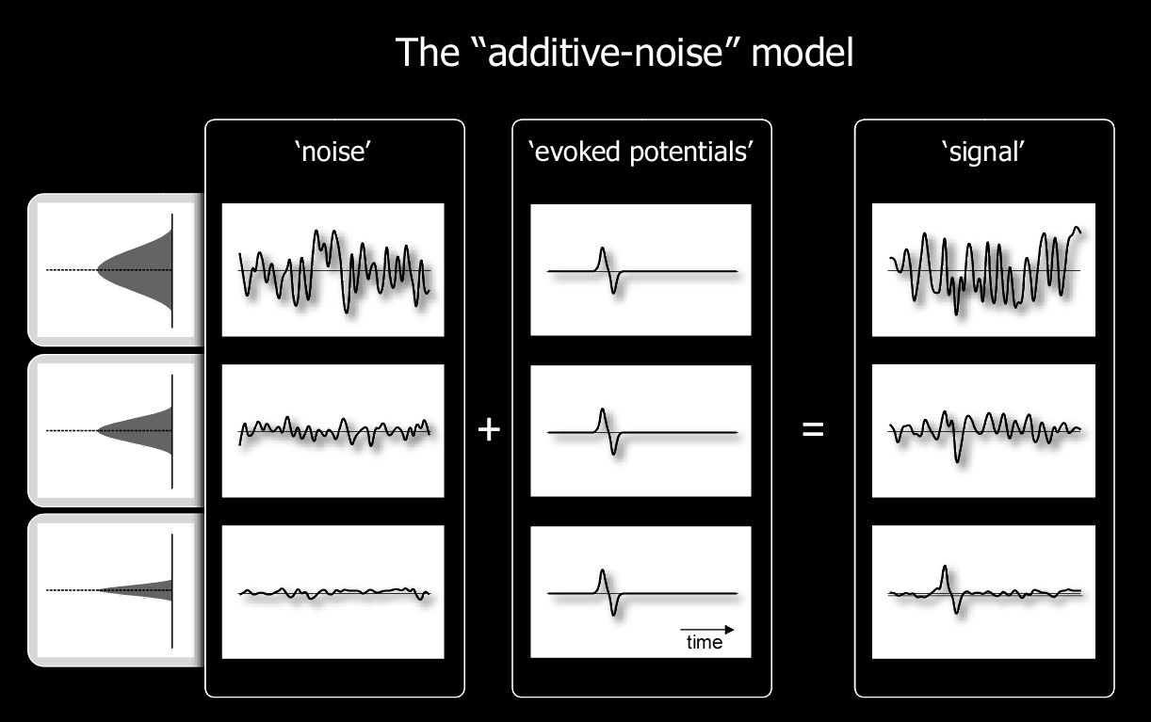
Across-trial averaging and the additive noise model
n=1
n=5
n=20

Slide 19
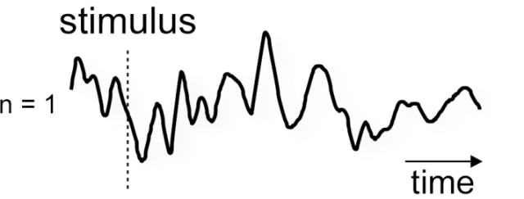
Across-trial averaging and the additive noise model

Slide 20
Event-related brain potentials: beyond standard averaging
Neural origin of the EEG signal: what are we measuring?
Basics of filtering and averaging
Standard-averaging and the additive noise model
Problem #1: Temporal jitter
Problem #2: Event-related modulation of oscillations (ERD/ERS)
Problem #3: Phase resetting
Indipendent Component Analysis (ICA) of event-related potential

Slide 21
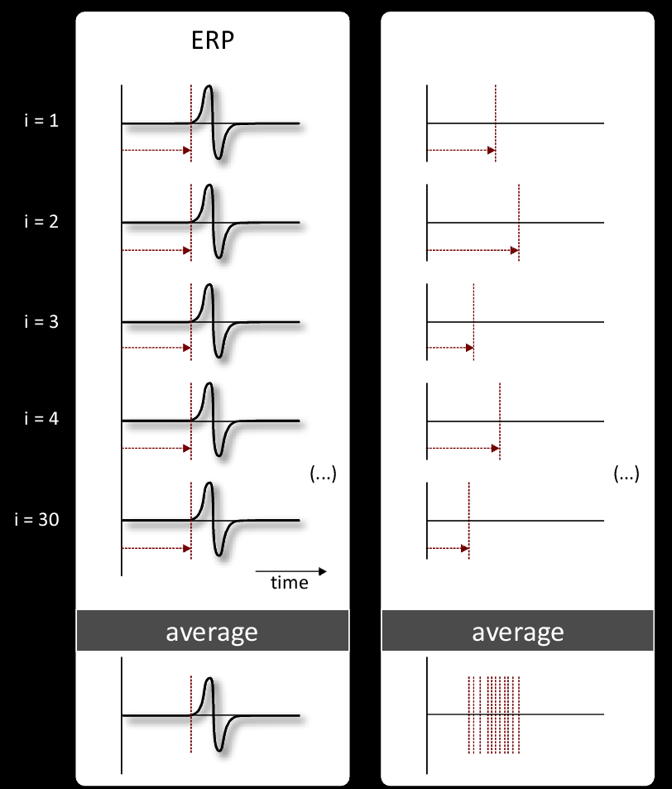
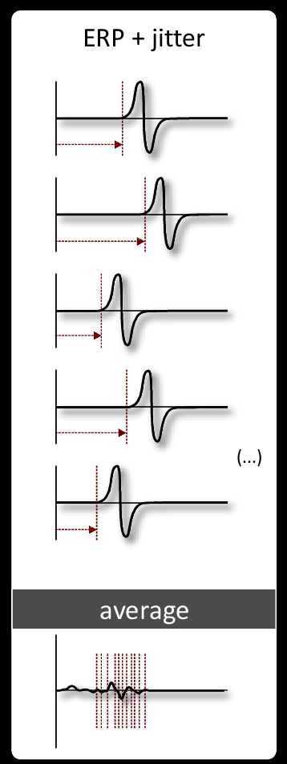
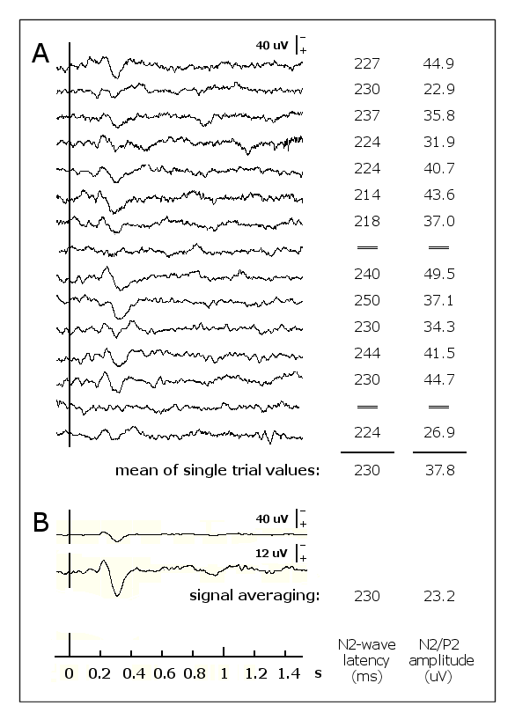
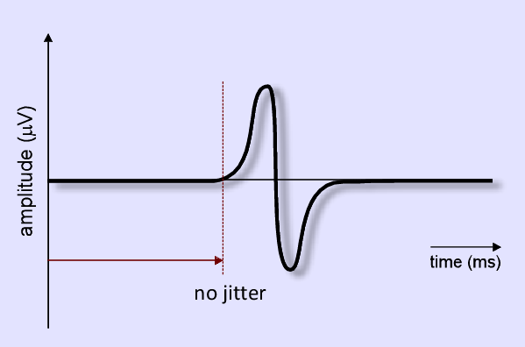
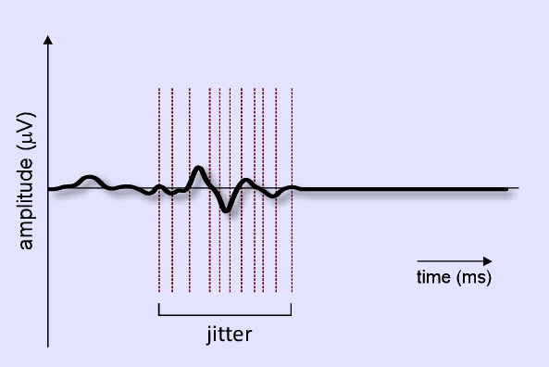
problem #1: temporal jitter
(Iannetti et al, Neuroscience 2005)

Slide 22
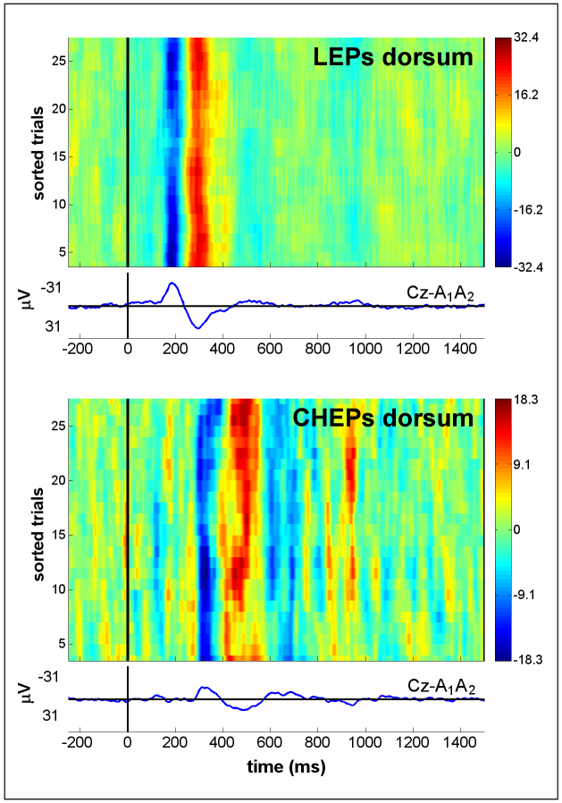
problem #1: temporal jitter
When jitter at single-trial level is different between conditions, traditional averaging could reveal spurious differences.
These differences are a potentially important confounding factor that must be taken into account to allow safe inference of physiological results.
(Iannetti et al, J Physiol 2006)
In order to rule out any contribution of jitter-dependent amplitude reduction of standard averages, all responses should be analysed at single-trial level

Slide 23
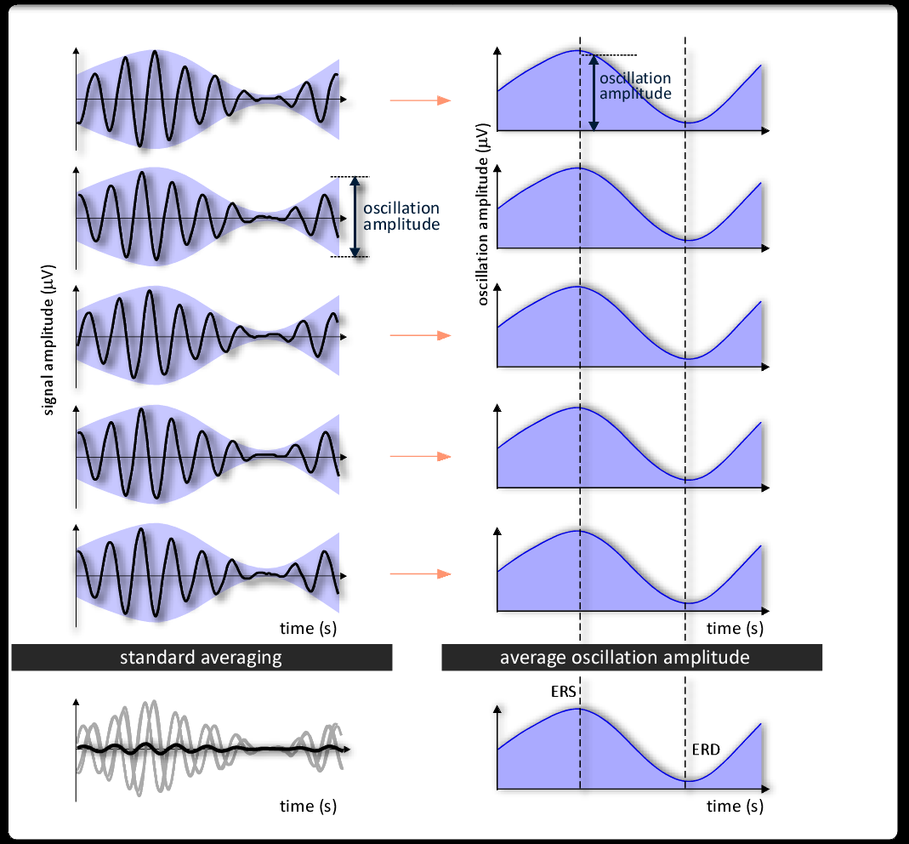
problem #3: ‘phase resetting’
Solution: compare stimulus-evoked amplitude changes in the average vs single trials.
ERD/ERS:
Pure phase-resetting:
Transient change in amplitude!
Transient change in phase!

Slide 24
problem #3: ‘phase resetting’ vs..
Solution: compare stimulus-evoked amplitude changes in the average vs single trials.
Pure phase resetting:
TF – SINGLE TRIALS
TF – AVERAGE
Transient change in phase!

Slide 25
… vs problem #2: ERD/ERS
Solution: compare stimulus-evoked amplitude changes in the average vs single trials.
Pure ERD/ERS:
TF – SINGLE TRIALS
TF – AVERAGE
Transient change in amplitude!

Slide 26
phase-locking value (a.k.a. inter-trial coherence)

Slide 27
phase-locking value (a.k.a. inter-trial coherence)

Slide 28
standard averaging: summary of limitations…

Slide 29
Take home messages – across-trial averging
The magnitude of ERPs is often several factors smaller than the magnitude of the background electroencephalogram.
Across-trial averaging is a widely-used approach to enhance the signal-to-noise ratio (SNR) of both evoked induced EEG responses.
The phase of ongoing EEG oscillations is not stationary across trials. Therefore, as these ‘non-phase-locked’ oscillations behave like uncorrelated noise, they are largely cancelled out by time-domain averaging.
Across-trial variability of response latency and amplitude contains physiologically-relevant information (fluctuations of peripheral input, vigilance, attentional focus and task strategy). This is lost when across-trial averaging is performed.
The availability of such information would allow a direct exploration of the dynamics between different features of ERPs/ERS/ERD, behavioural variables and measures of brain activity sampled using different neuroimaging techniques.

Slide 30
..and summary of (possible) solutions!
Problem #1: Temporal jitter
Solution: Estimation of latency and amplitude values for each single-trial (by multiple linear regression or functional localiser of TFD)
Problem #2: Non phase-locked ERD/ERS
Solution: Evaluation of modulation of stimulus-evoked oscillation changes (by time-frequency decomposition of each single trial)
Problem #3: Phase-resetting
(Partial!) solution: Comparison of time-frequency decomposition of single trials vs average. Calculation of Inter Trial Coherence

Slide 31
Wavelet filtering to enhance ERP signal-to-noise ratio

Slide 32
Wavelet filtering to enhance ERP signal-to-noise ratio

Slide 33
Wavelet filtering to enhance ERP signal-to-noise ratio

Slide 34
Wavelet filtering to enhance ERP signal-to-noise ratio

Slide 35
Wavelet filtering to enhance ERP signal-to-noise ratio

Slide 36
Wavelet filtering to enhance ERP signal-to-noise ratio

Slide 37
Multiple linear regression…
(Mahyew et al, CLINPH 2006)

Slide 38
Variability of single-trial latency…
and morphology
(Iannetti et al, Neuroscience 2005)

Slide 39
Multiple linear regression…
with dispersion term
(Mahyew et al, CLINPH 2006)

Slide 40
Generation of a realistic ERP dataset

Slide 41
Wavelet filtering to enhance ERP signal-to-noise ratio

Slide 42
Detection bias (on a real ERP dataset)

Slide 43
Single-trial estimation - a real ERP dataset

Slide 44
Correlation with behavioural measures
(Hu et al, Neuroimage 2010)

Slide 45
‘phase-locked’ and ‘non-phase-locked’ EEG responses
(Mouraux et al, CLINPH 2005)

Slide 46
Time-frequency ROIs definition

Slide 47
Multiple linear regression in the time-frequency domain…

Slide 48
…taking ROI morphology into account.

Slide 49
MLR vs dMLR

Slide 50
Single-trial correlations

Slide 51
Take home messages – across-trial averaging
The magnitude of ERPs is often several factors smaller than the magnitude of the background electroencephalogram.
Across-trial averaging is a widely-used approach to enhance the signal-to-noise ratio (SNR) of both evoked induced EEG responses.
However, across-trial variability of response latency and amplitude contains physiologically-relevant information (fluctuations of peripheral input, vigilance, attentional focus and task strategy). This is lost when across-trial averaging is performed.
The availability of such information would allow a direct exploration of the dynamics between different features of ERPs, behavioural variables and measures of brain activity sampled using different neuroimaging techniques.

Slide 52
Summary and possible applications
Wavelet filtering significantly enhances the SNR of ERPs/ERS/ERD in single trials.
Multiple linear regression effectively captures the variability in the morphology of single-trial ERPs.
Combined, WF and MLR provides accurate and unbiased estimate of their peak latency and amplitude.
Within subject comparison!
Correlation with behavioural responses (perception, performance, reaction times - SDT), stimulus features, prestimulus features, experimental factors (e.g. drug concentration).
Correlation with other laboratory measures (withdrawal reflexes, EMG, BOLD-fMRI, MEG).
Robust estimation even in average waveforms (e.g. patient and drug studies)

Slide 53
Simultaneous EEG-fMRI
Scalp EEG
sensory
stimulus
neurovascular
coupling
BOLD
fMRI
neural activity
haemodynamic response
Notes:
That we have already seen, showing EEG and fMRI, two of the most widely used techniques to sample brain activity. While EEG has an excellent ability to resolve two neural events in time, its ability to resolve neural events in space is quite poor, and exactly the opposite happens for fMRI – this because the different nature of the physiological processes sampled. For this reason it is highly desirable to combine them, and how to do this in a proper way is one of the hot topic of modern system neuroscience, because it could potentially provide maps of brain activity with very high spatial and temporal resolution.

Slide 54
Simultaneous EEG-fMRI
+
EEG
fMRI
Notes:
We tried to do this it, and from a technical point of view it is very challenging, because there are massive artefacts when the two systems work together – this is an example of how EEG looks like when the MR gradients are switched on! This problem was approached by a team of people at the Oxford fMRIB centre and in the Engineering department, and we developed a robust algorithm to clean this MR-induced noise on the EEG..

Slide 55
Basics concepts of functional neuroimaging: EEG vs BOLD-fMRI
+
EEG
fMRI
MR-induced artifact on EEG
signal recovery!
“cleaning” algorithm..
(www.fmrib.ox.ac.uk/~rami)
Notes:
We tried to do it, and from a technical point of view that is very challenging, because there are massive artefacts when the two systems work together – this is an example of how EEG looks like when the MR gradients are switched on! This problem was approached by a team of people from the Oxford fMRIB centre and the Department of Engineering, and we developed a robust algorithm to clean this MR-induced noise on the EEG..

Slide 56
Simultaneous EEG-fMRI of somatosensory-evoked ERPs
(Iannetti et al NeuroImage 2005)
Notes:
And by exploiting this “cleaning” algorithm we showed that EEG responses evoked by laser stimuli are fully detectable even during a truly simultaneous fMRI scanning, and both the amplitude of waveforms and the topography of scalp distribution are correctly preserved. This is a very technical paper, but it is a proof of concept that this can be done, and it al quite relevant for me because I will certainly use these combined techniques in a good part of the experiments I am planning for the next 5 years.

Slide 57
EEG-driven analysis of the fMRI responses to sensory stimulation
Single-trial estimates of ERP amplitude (e.g. Mayhew et al. 2006; Hu et al NeuroImage 2010) are used to build a function of the predicted hemodynamic response, which is then used to analyse the fMRI timeseries. The method identifies voxels whose BOLD signal time course correlates with the trial-to-trial variability of the measured EEG response.
Notes:
5 subjects
Analysis was done using a mixed effects analysis and cluster–based thresholding (z>2.3, p<0.05).
The first (EV1) represents the average amplitude of the peak of interest.
The second (EV2) represented the trial-to-trial variability of the peak of interest.
Note how the variability of the N2 peak correlates with the BOLD signal time course of voxels located in the ipsilateral and contralateral posterior insula.

Slide 58
EEG-driven analysis of the fMRI responses to sensory stimulation
Frequency (Hz)
Time (s)

